Slide 1
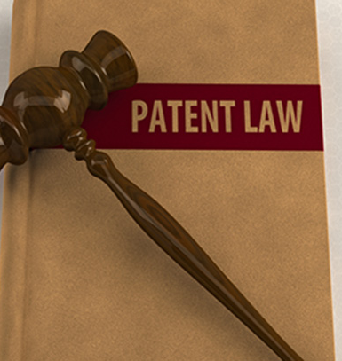
PATENT
Mina Radulovic 924 m
Jovana Nikolic 948m
This Photo by Unknown author is licensed under CC BY-SA-NC.

Slide 2
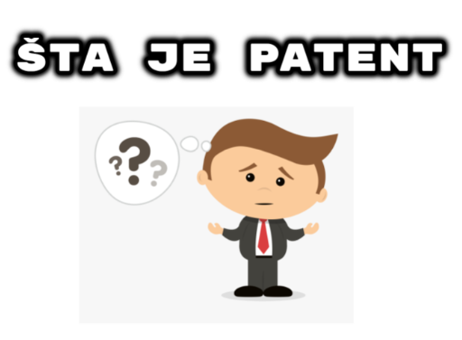
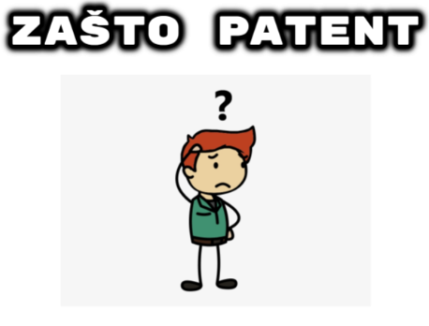
Patent je isključivo pravo priznato za izum koji nudi novo rešenje nekog tehničkog problema, patent se priznaje za proizvode koji se odnose na proizvod,postupak I primenu.
Patent osigurava vlasniku isključivo pravo na izradu,korišćenje,stavljanje u promet ili prodaju izuma zaštićenog patentom,patent je zapravo vlasništvo čiju upotrebu vlasnik može delimično ili u potpunosti prepustiti drugim osobama.

Slide 3
Patenti se dele na
Patent
Mali patent

Slide 4
Razlika izmedju patenta i malog patenta
PATENT
MALI PATENT
PREDMET ZAŠTITE: Proizvod,postupak,primena proizvoda i primena postupka
PREDMET ZAŠTITE:Ovde može biti samo rešenje koje se odnosi na konstrukciju nekog proizvoda ili raspored njegovih sastavnih delova
PO VREMENU TRAJANJA: Patent traje 20 godina od dana podnošenja prijave
PO VREMENU TRAJANJA: Mali patent traje 10 godina od dana podnošenja prijave
PO POSTUPKU PO PRIJAVI: Prijava patenta i malog patenta se razlikuje
PO POSTUPKU PO PRIJAVI: Prijava malog patenta se ne objavljuje ,ne ispituje se da li je predmet za koji se treži zaštita nov, da li ima inventivni nivo itd.

Slide 5

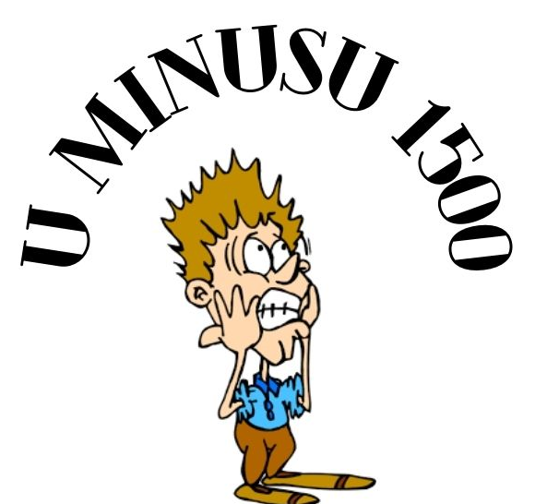




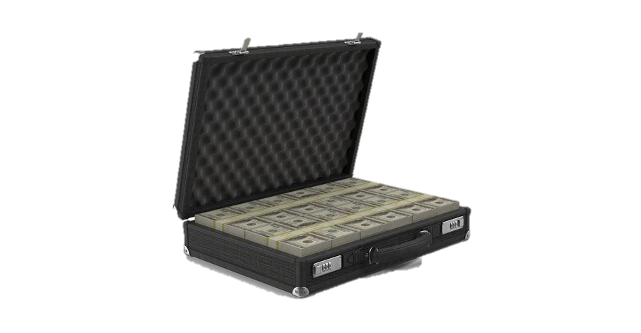


Zaštita patentom ili malim patentom znači da se proizvod ne sme komercijalno izradjivati, koristiti, stavljati u promet ili prodavati bez saglasnosti njegovog nosioca. Nosilac ima prava da odluči ko može a ko ne može da koristi njegov pronalazak za vreme trajanja zaštite.
Nosilac prava moze da da licencu drugim licima pod uslovima koji će biti predmet njhovog medjusobnog ugovora.
Nakon isteka prava pronalazak koji je pod zaštitom postaje javno dobro to dalje znači da pronalazak postaje slobodan za komercijalno korišćenje.
Notes:
§Vlasnik patenta ima pravo da odluči ko može -ili ne može - da koristi patentirani pronalazak u periodu u kome je pronalazak zaštićen.
§Vlasnik patenta može da da dozvolu, ili licencu, drugim stranama da koriste pronalazak pod zajednički dogovorenim uslovima.
§Vlasnik može, takođe, da proda prava na pronalazak nekom drugom koji tada postaje novi vlasnik patenta.
§Kada jednom patent istekne, zaštita prestaje i pronalazak ulazi u javni domen, to jest vlasnik više nema isključiva prava na pronalazak, koji postaje dostupan i svima drugima za komercijalno iskorišćavanje.

Slide 6
Šta se može patentirati
Pronalazak može biti patentiran samo ako je
Nov I prethodno neobjavljen pronalazak
Ima inventivan nivo koji nije očigledan ekspertu u toj oblasti tehnologije
Industrijski primenljiv-da li je moguće proizvesti I upotrebiti pronalazak
Kompjuterski program može samo biti zaštićen autorskim pravom ali ne I patentom u Evropi.

Slide 7
Šta se ne može patentirati?
Otkriće, naučna teorija I matematički metod
Estetska reacija
Šema, pravilo ili metod za izvođenje mentalnog čina, igranje igre, biznisa ili kompjuterski program
Prezentacija informacija
Medicinska dijagnoza, procedura za hirurški ili terapeutski tretman

Slide 8

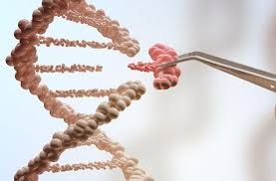

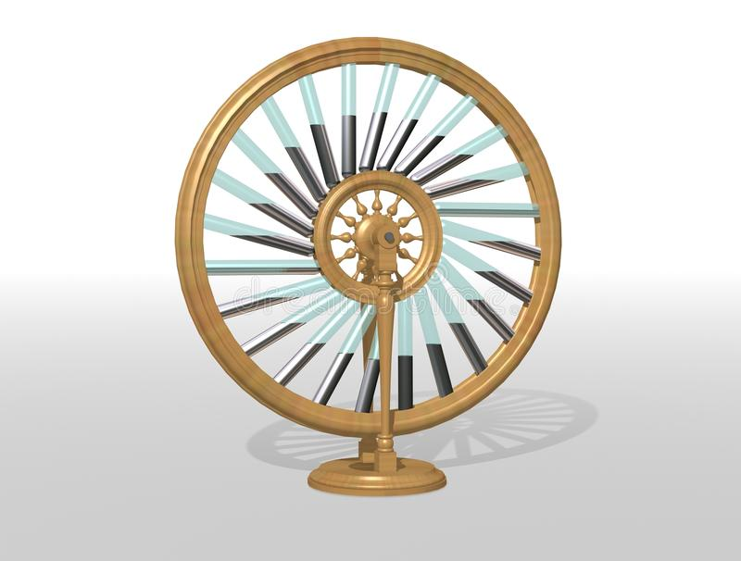
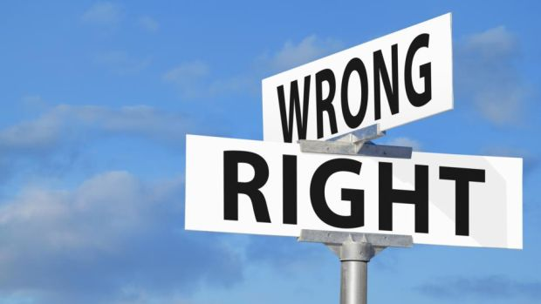
Softver I biznis model
Biotehnologija
Medicinski metod
Perpetum mobile mašina
Moralnost
Notes:
https://www.prv.se/en/patents/applying-for-a-patent/before-the-application/what-cannot-be-patented/

Slide 9

Patentirani pronalsci zadiru u svakodnevni aspekt ljuduskog života,oni mogu biti pribavljeni za bilo koju vrstu tehnologije,od prenosa električne energije pa sve do hemijskih olovaka ,plastike,predmeta od recikliranog materijala itd.
Odlukom vrhonog suda iz 2013. Godine je kompaniji Myriad genetics zabranjen patent nad dva gena BRCA1 I BRCA2 koji imaju ulogu u formiranju karcinoma jajnika I dojke
Informacije o tome da li je odredjeni pronalazak zaštićen stiču se pretraživanjem patentnih dokumenata to su registrovani patenti i objavljene prijave patenata.
Potrebne informacije pružaju i stručnjaci iz Zavoda nakon složene pretrage u domaćim i inostranim bazama podataka na osnovu zahteva zainteresovanih lica, tu postoji i usluga javne čitaonice gde se zainteresovanom licu stavljaju na uvid dokumenta o zaštićenim pravima industrijske svojine.
Notes:
hereby giving them the right to limit others from doing research or diagnostic testing of the genes, which can be crucial for individuals making important medical decisions. The patents also allowed Myriad to set the terms and cost of testing and made it difficult for women to access alternate tests or get a comprehensive second opinion about their results.

Slide 10
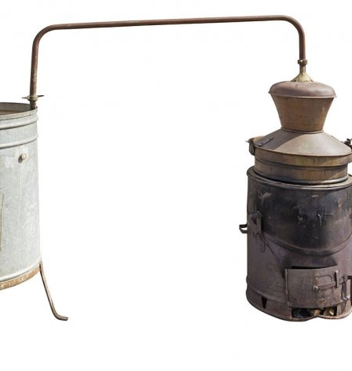
Prvi patent u Srbiji
Slika preuzeta sa sajta https://www.ekapija.com/news/1637090/koji-je-prvi-patent-registrovan-u-srbiji
Prvi zakon koji je u Srbiji regulisao ovu materiju donela je Kraljevina Srbija i nosio je naziv „Zakon o zaštiti mustara i modela“ 1884 godine. Medjutim trebalo je da prodje dosta vremena od tada da bi postojala solucija da se registruje patent, 15. novembra 1920 godine Aleksandar Karadjordjević potpisao je Uredbu o zaštiti industrijske svojine.
Prvi patent registrovan je u Upravi 1921. godine a reč je o „Uredjaju kazana za pečenje rakije “ pronalazača Milana T. Jovnanovića.

Slide 11

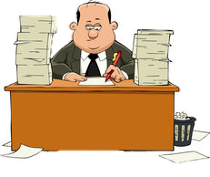
Dobar dan, zelim da patentiram moj izum
Dobar dan, dozvolite mi da vam objasim po koracima

Slide 12
1
Podnošenje patentne prijave
-formular prijave gde se zahteva da opišemo naš pronalazak
-forlulari se dobijaju od zavoda za patent svake države
-smatra se korisnim I za fizička I za pravna lica da imaju zastupnika
-detalji o podnosiocu
-opis izuma
-crtezi
Notes:
Your patent attorney must provide documentation consisting of:
A request for a patent.
Details of the applicant (you).
A description of the invention.
Claims.
Drawings (if any).
An abstract.
A fee must also be paid. In order to avoid delay, it is vital that all documentation conforms in every detail to official requirements. Your patent attorney will ensure that it does. At the EPO, applications are accepted in English, French or German.
For your patent attorney to prepare all the information about your invention, he or she will obviously need to work closely with you. Do not assume that you know best because it is your invention. You must trust the skill and judgement of your patent attorney, as patenting involves a complex mix of law and technology. The claims in particular need to be drafted with skill, as they are the most important aspect of a patent.

Slide 13
2
Utvrdjivanje datuma I inicijalna provera
-Sektor za patente ispituje da li prijava ispunjava uslove za priznanje datuma za podnošenje prijave
-Ukoliko utvrde da nedostaje deo opisa poziva podnosioca prijave da u roku od dva meseca dostavi deo opisa
-Ako podnosilac prijave otkloni nedostatke Zavod priznaje datum podnošenja prijave kada je podnosilac otklonio nedostatke

Slide 14
3
Formalno ispitivanje
-Zavod će izvršiti ispitivanje I proveru da li se pronalazak odnosi na predmet zaštite koji se može štititi patentom/malim patentom

Slide 15
4
Izveštaj o pretraživanju
-Izveštaj o pretraživanju stanja tehnike po predmetu pronalaska je izveštaj o pretraživanju nacionalnih i međunarodnih baza podataka koji čine stanje tehnike koji Zavod dostavlja podnosiocu prijave patenta posle podnošenja zahteva za izradu izveštaja o pretraživanju i uplate odgovarajuće takse
-od ovog izveštaja zavisi mogućnost patentiranja u inostranstvu

Slide 16
5
Rešenje
-Rešenje o priznanju patenta donosi se ako su ispunjeni svi uslovi za priznanje patenata sa kojima podnosilac treba da se saglasi u roku od 30 dana.
-Rešenje se donosi I ako su dostavljeni dokazi o uplatama takse za ispravu o priznatom pravu
-Propisani podaci o priznatom pravu upisuju se u odgovarajući registar
-Nosiocu patenta izdaje se isprava o priznatom pravu
-Priznato pravo objavljuje se u službenom glasilu
Notes:
After your patent is granted, you may claim damages for infringements originating as far back as the publication date of your application. However, to enjoy this right in some countries it may be necessary to file a translation of your claims with their national IP office and for them to publish the translated claims.
You then have six further months to make two decisions:
Do you want to continue with your application? You indicate ‘yes' by requesting a more thorough (‘substantive') examination.
Which countries do you want to include (‘designate') in your patent protection? Designation fees must be paid.

Slide 17
6
Dodatno ispitivanje
-tri EPO ispitivaca, od kojih je jedan u kontaktu sa advokatom podnosioca prijave
-medjusobni razgovori izmedju njih
-bitno imati dobrog advokata
Notes:
If you request substantive examination, the EPO has to decide whether your invention and your application meet the requirements of the European Patent Convention. For maximum objectivity there are usually three EPO examiners, one of whom maintains contact with your patent attorney. This stage will often involve dialogue between the examiners and your patent attorney, which may result in the re-drafting of key parts of your application. Your patent attorney will defend your application, and this is one more reason why it is essential to have professional representation.

Slide 18
7
Validacija
-u svakoj zemlji gde si trazio patent mora se validirati u odredjenom vremenskom periodu
-ukoliko ne u toj drzavi patent moze da ne bude priznat
Notes:
After your patent is granted, you may claim damages for infringements originating as far back as the publication date of your application. However, to enjoy this right in some countries it may be necessary to file a translation of your claims with their national IP office and for them to publish the translated claims.
You then have six further months to make two decisions:
Do you want to continue with your application? You indicate ‘yes' by requesting a more thorough (‘substantive') examination.
Which countries do you want to include (‘designate') in your patent protection? Designation fees must be paid.

Slide 19
8
Opozicija
-Najcesce trece partije, konkurenti aplikanta
-9 meseci nakon objave u Evropskom biltenu patenata
-najcesce se optuzuje da nije nov ili inovativan
-ponovo se slucaj ispituje sa 3 EPO strucnanjaka
-Poslednje mesto za napad patenta kao jednog entiteta
END
Notes:
Opposition is the last chance to attack a European patent as a single entity in a single forum. Later, the patent can only be challenged in national courts and a ruling in one country has no effect on the patents for the same invention in other countries. This gives competitors a strong incentive to challenge an invention during the opposition period, as challenging patents in separate national courts can be much more expensive.

Slide 20

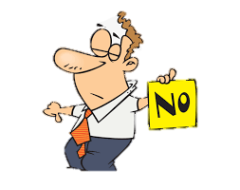
Patentirati da ili ne
Patent ti daje mogucnost stopiranja drugih od kopiranja, proizodnje, prodaje ili uvoza tvojih proizvoda bez tvoje dozvole
Uzima se na tacno specifirani period
Ti smes koristiti izum
Mozes licencirati ili prodati patent
Patent mora da sadrzi neke tehnicke informacije o vasem izumu javno
Oduzima mnogo vremena
Jako je skupo
Nekada ne znate koliko je finansijski isplativo
Svake godine morate plaćati trošak za održavanje patenta
Spremni za troškove odbrane patenta
Notes:
Advantages of patents
A patent gives you the right to stop others from copying, manufacturing, selling or importing your invention without your permission. See protecting intellectual property.
You get protection for a pre-determined period, allowing you to keep competitors at bay.
You can then use your invention yourself.
Alternatively, you can license your patent for others to use it or you can sell it. This can provide an important source of revenue for your business. Indeed, some businesses exist solely to collect the royalties from a patent they have licensed - perhaps in combination with a registered design and trade mark. See how to license a patent.
If you're considering securing trade mark protection, see benefits of trade mark registration.
Disadvantages of patents
Your patent application means making certain technical information about your invention publicly available. It might be that keeping your invention secret may keep competitors at bay more effectively.
Applying for a patent can be a very time-consuming and lengthy process (typically three to four years) - markets may change or technology may overtake your invention by the time you get a patent.
Cost - it will cost you money whether you are successful or not - the application, searches for existing patents and a patent attorney's fees can all contribute to a reasonable outlay. The potential for making a profit should outweigh the time, effort and money it takes to get and maintain a patent. Not all patents have financial value.
You'll need to remember to pay your annual fee or your patent will lapse.
You'll need to be prepared to defend your patent. Taking action against an infringer can be very expensive. On the other hand, a patent can act as a deterrent, making defence unnecessary. Read more about patent protection and enforcement.

Slide 21
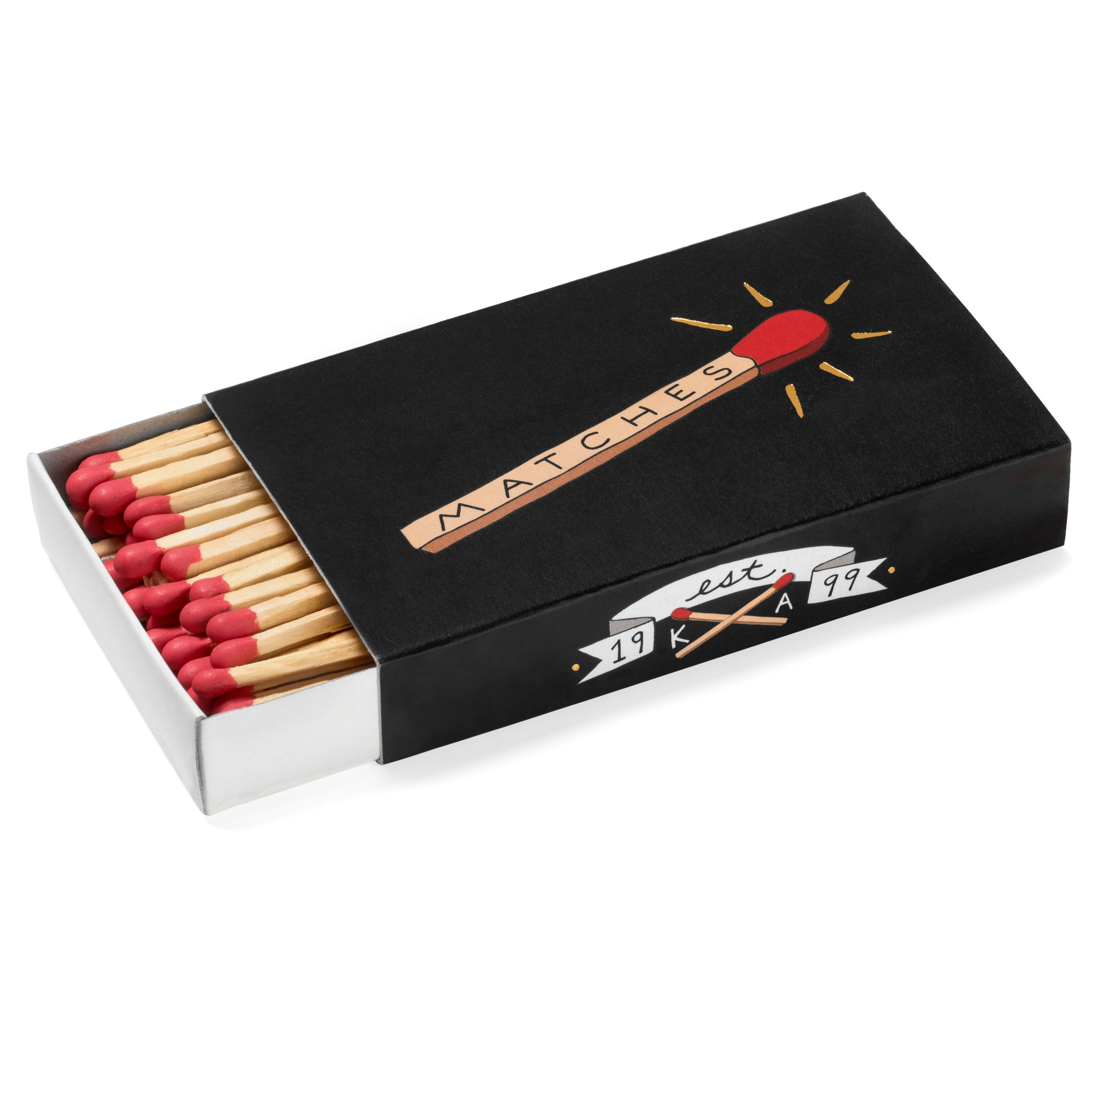
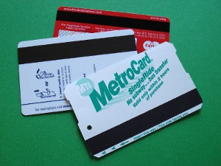
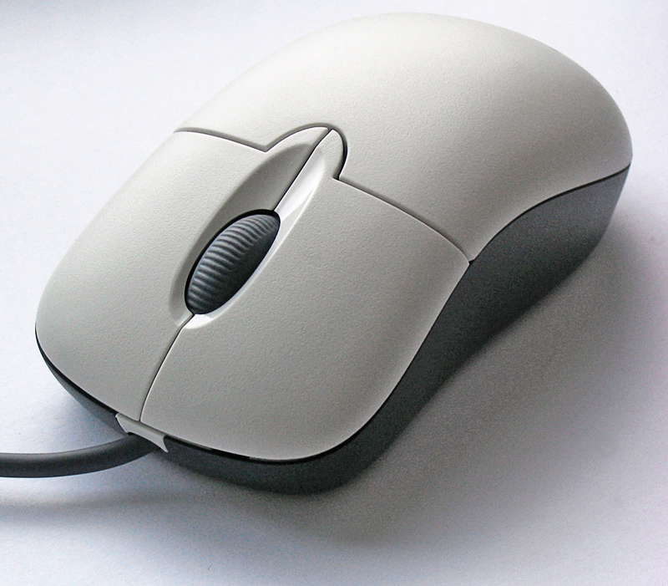
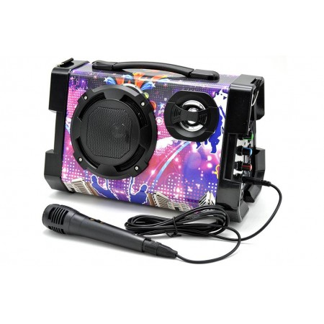
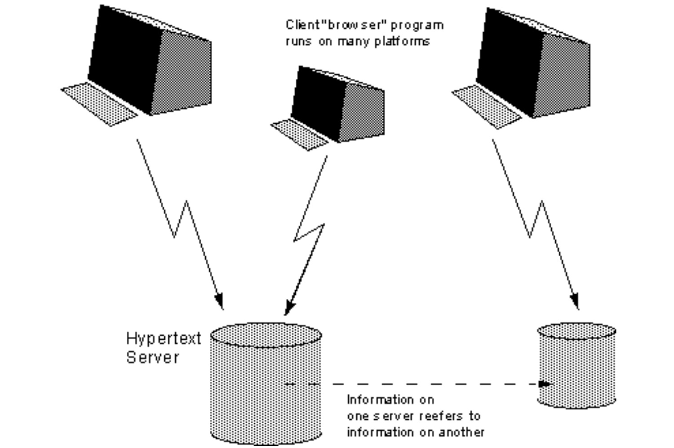
Primeri Izgubljenog novca
Ron Klein
Magnetna traka
Dzon Voker
Sibice
Douglas Engelbart
Mis
Daisuke Inoue
Karaoke
Tim Berners-Lee Hipertekst dokument
protokol
Notes:
Your perception of the world around you changes when you realize that every single man-made object in your life was deliberately thought up by another human being. Case in point: matches. The idea of scraping a little stick to make fire seems like it's been around forever, but they were actually invented in 1824 by a British chemist named John Walker. Walker was unusual among his peers for his willingness to experiment with various man-made substances, and when he came up with a sulfur paste that sparked when it was scraped on a rough surface, it wasn't long before he was selling the world's first friction matches. Walker refused to patent his invention because he was concerned with the safety of the flame, so billions of dollars in profit was made off of it without him seeing a dime.
It's hard to think of a cultural phenomenon that has had the reach or staying power of karaoke. That kind of invention comes along once a generation at most. That's why it's painful to hear that the man who came up with the concept and built the first karaoke machines never saw a dime from it. Daisuke Inoue was the drummer in a Japanese bar band that would let salarymen hop up on stage and croon along to their favorite hits. One day, a guy asked him to record backing tracks so he could sing without the band, and karaoke was born. In 1971, Inoue produced eleven units of the Juke 8, a standalone machine with an 8-track tape player, a microphone, and a coin slot. He never patented the idea, and it wasn't long before more technologically sophisticated karaoke machines were all over Tokyo.
Without the invention of Tim Berners-Lee, you wouldn't be reading this article. No, he didn't come up with the bathroom break. While working at CERN in the late 1980s, he wrote a proposal for a method to share hypertext documents over the Internet, creating what we know as the World Wide Web. That nefarious network of websites has come to reshape the way we live in the modern world, but Berners-Lee didn't patent his concept. Instead, he released the protocol out into practice, and it wasn't long before everybody was using it. He's done pretty well for himself even without that payout, though, and was knighted a member of the Order of the British Empire in 2004.
There are hundreds of millions of copies of Ron Klein's invention in the United States alone, one of the most important developments modern capitalism has ever seen. You see, he invented the magnetic stripe on the back of your credit or debit card that lets stores scan and connect to your account to pull money out. Back in the day, stores had to check numbers against a huge list of bad cards manually, and it was a royal pain. Klein took the same technology used in reel-to-reel tape recorders and affixed it to the back of a card, then encoded the number on it and created a scanner to compare that data with a regularly updated database of bad cards. He never patented the magnetic stripe idea, so it was quickly adopted by pretty much every company under the sun. Don't cry for Klein, though, as he did just fine from a bunch of other inventions.
A lot of these tales involve inventions that are simply too far ahead of their time to be profitable. In 1961, Doug Engelbart came up with a device that would let computer users select a coordinate on the screen. It involved a pair of wheels at the bottom of a wooden block that would record movement and translate it to the machine. The patent was granted to his employer in 1970, but shortly after, a Xerox scientist took Engelbart's concept and modified it to use a ball instead, which was enough to file for a separate patent and cut him out of compensation entirely. Just being the first person to have an idea isn't enough if someone else can implement it more effectively.

Slide 22
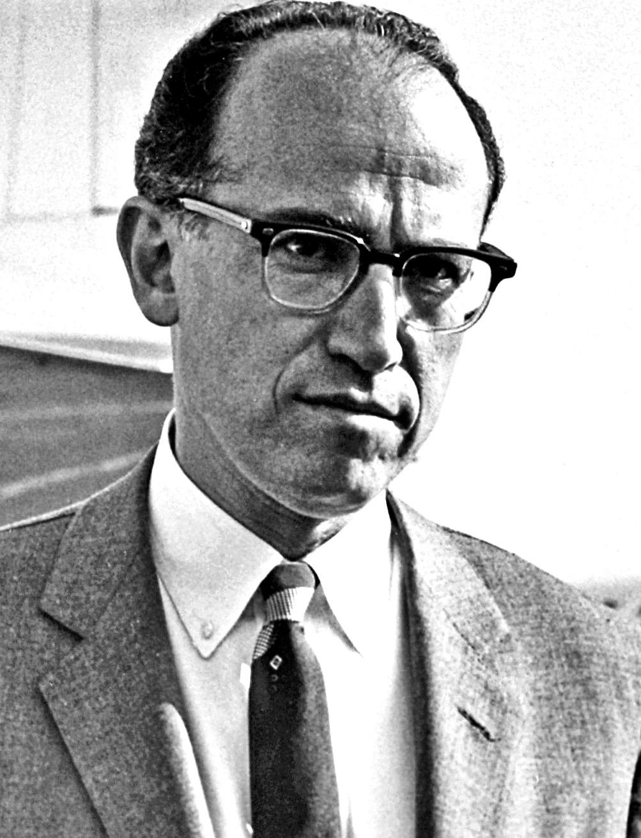
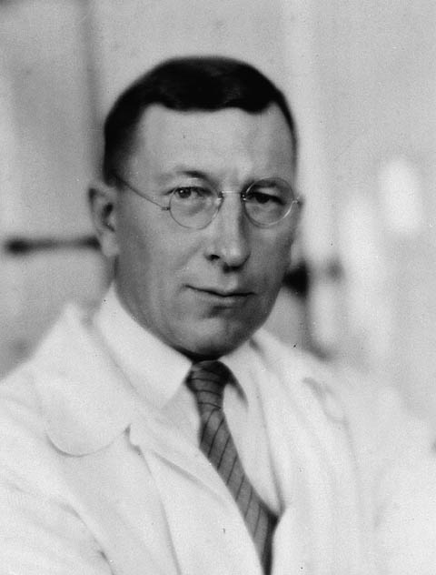
Postoje I neki humanisti
Jonas Salk
Vakcina za polio
Fredrick Bantin
Insulin
Notes:
When Salk came up with the vaccine to eradicate polio and released it to the world in 1955, newsman Edward R. Murrow asked him who the patent belonged to. "The people, I would say. There is no patent. Could you patent the sun?" Common wisdom says that Salk refused the patent because he wanted the global health crisis of polio to be abated, but actually the Salk Institute had explored the possibility only to conclude that an application would likely be denied due to the "prior art" clause. Whatever the reason, the fact that such a nightmarish disease has been mostly swept from the earth is a testament to how an invention can change the world without making its creator a ton of money.
When inventor Frederick Banting discovered insulin in 1923, he refused to put his name on the patent. He felt it was unethical for a doctor to profit from a discovery that would save lives. Banting’s co-inventors, James Collip and Charles Best, sold the insulin patent to the University of Toronto for a mere $1. They wanted everyone who needed their medication to be able to afford it.

Slide 23
Patentni ratovi
LITTON VS HONEYWELL (1993) – $1.2 BILLion
LUCENT VS MICROSOFT (2007) – $1.5 BILLION
PFIZER VS TEVA PHARMACEUTICALS AND SUN PHARMA (2013) – $2.1 BILLION
Notes:
A patent war is a "battle" between corporations or individuals to secure patents for litigation, whether offensively or defensively. There are ongoing patent wars between the world's largest technology and software corporations. Contemporary patent wars are a global phenomenon, fought by multinational corporations based in the United States, China, Europe, Japan, Korea and Taiwan.[1][2][3] Patent wars have occurred in a wide range of technologies, both in the past and in the present.
The first and oldest case on this list also took the longest to resolve, having begun in 1990 and finally being settled in 2001. The plaintiff, Litton Industries Inc., filed suit against fellow aerospace company Honeywell Inc., alleging patent infringement in its use of a thin-film process to coat mirrors inside ring laser gyroscopes on aeroplanes – a technique that Litton and Honeywell, as the two main suppliers of the device, used to dominate the market for inertial navigational systems in aircraft. Honeywell filed a counterclaim alleging that Litton had attempted to monopolise the market and interfere with Honeywell’s relationship with suppliers.
A federal jury found that Honeywell had intentionally interfered with Litton’s economic advantage and caused damages to projected profits equivalent to $830 million before the expiration of Litton’s patent and $360 million following it, for a total of almost $1.2 billion. The jury’s decision was remanded by the Federal Circuit upon appeal, and the district court granted Honeywell SJ and JMOL of noninfringement. Although this decision was remanded by the FC in 2001, Litton went on to be acquired by Northrop Grumman that same year.
In 2003, Lucent Technologies Inc. – which would merge with Alcatel in 2006 to become Alcatel-Lucent – filed suit against Microsoft, claiming that the MP3 capabilities of Windows Media Player infringed its patents on its MP3 and MPEG encoding and compression technologies, among others. In February 2007, a San Diego jury found in favour of Alcatel-Lucent and awarded the company $1.52 billion in damages.
While this figure was record-breaking at the time, Microsoft was never made to pay it. The company appealed the jury’s decision, claiming that it had already paid $16 million to license its MP3 technology from Fraunhofer IIS, the co-owner of one of the patents in question. It also noted that Lucent had not proved that Microsoft had used the patented algorithms in its products. The Court of Appeals dismissed the case, and Microsoft and Alcatel-Lucent later agreed to settle most of the litigation out of court.
In 2007 and 2008 respectively, Teva Pharmaceuticals and Sun Pharma launched generic versions of Pfizer Inc.’s acid reflex drug Protonix. In so doing, they pre-empted the 2011 expiry date of the patent on Protonix’s active ingredient, pantoprazole, cutting into as much as 60% of Pfizer’s sales and taking a chance that ongoing patent litigation would end in their favour (an example of an “at-risk” launch).
YOU MAY ALSO BE INTERESTED IN:
Microbes and Skincare – Insights from Innovator Activity at the European Patent OfficeWorld IP Day: Are Patents Proving that the World Will Become Greener?
The gamble did not pay off for Teva and Sun Pharma. In 2010 they were ordered to take their products off the market after a near decade-long series of legal defeats, and their counter-allegation that the patent for Protonix – a widely-used drug – was obvious and should be declared invalid was rejected by a district court. Finally, Teva and Sun Pharma were forced to settle the case with Pfizer for a staggering $1.6 billion and $550 million respectively. The case marked the first instance of a generic drugmaker being forced to pay damages for mimicking an existing drug covered by as-yet unexpired patents.

Slide 24
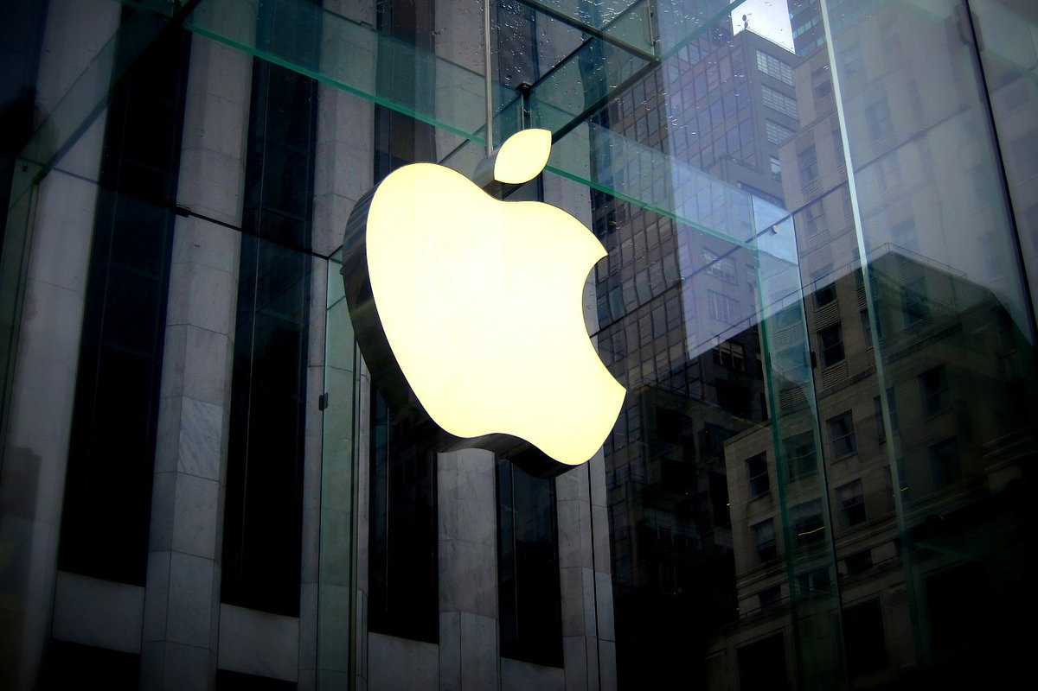
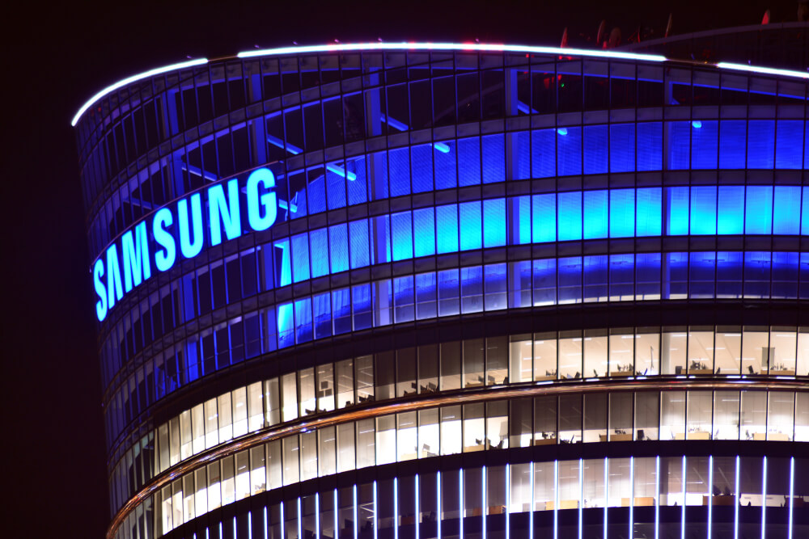
SAMSUNG
7 GODINA
APPLE
1 MILIJARDA
539 MILIONA
VS
Skrolovanje
Prtisak za uvecanje
Dizajn patent koji se odnosi na poziciju zvučnika, staklo od ivice do ivice, ivice ekrana
Dizajn patent koji se odnosi na home dugme, zaobljene ivice
IOS raspored ikona
Dizajn patent za iPad
Notes:
Apple and Samsung settle seven-year-long patent fight over copying the iPhone - The Verge

